Slide 1
NUX VOMICA
Prepared By Dr.SREEJA.S
H.o.D, Dept of Homoeopathic Pharmacy

Slide 2
Botanical Name: Strychnos nux-vomica Linn.
Family: Loganiaceae
Common Names: Nux-vomica, Poison Nut, Snake-wood, Strychnine Tree, Quaker Buttons, Yetti (Tamil), Kanjiram (Malayalm)
Part used : Dried seeds(nut)

Slide 3
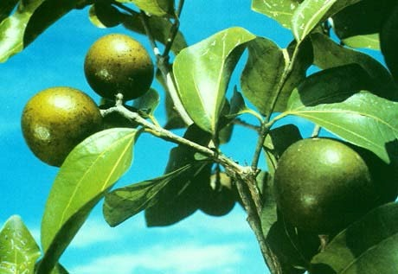
NUX VOMICA

Slide 4
Morphological characteristics
Strychnos species is a medium-sized, deciduous tree, with fairly straight and cylindrical and dark-grey or yellowish-grey bark with minute tubercles. The nux vomica grows as tall as 49.2 ft (15 m).
LEAVES :The nux vomica has roundish, opposite leaves and attractive white flowers. Leaves are simple, opposite, orbicular to ovate, 6–12 cm long and 6–10 cm broad, glabrous, and five-nerved.

Slide 5
FLOWERS of kuchila are white or greenish white and fragrant.
The roughly spherical FRUITS of the nux vomica are large hard-rinded berries that contain three to eight round, flattened, grayish seeds.
. Fruit is an indehiscent berry, 5–6 cm in diameter, thick shelled, orange- red when ripe with fleshy pulp.

Slide 6
SEEDS are discoid, compressed, and coin like, concave on one side and convex on the other, and covered with fine grey silky hairs. Flowering occurs from March to May and fruits mature up to December.
SEEDS covered with silky hairs, are known as strychnine nuts, and are hard and extremely bitter in taste

Slide 7
DISTRIBUTION
Strychnos nux-vomica is the name of an evergreen tree native to south East Asia, especially India and Myanmar, and cultivated elsewhere.
The species is indigenous to India and is distributed in moist deciduous forests throughout the tropical India

Slide 8
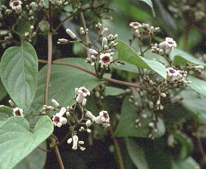
NUX VOMICA FLOWER

Slide 9
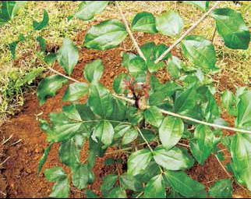
NUX VOMICA LEAF

Slide 10
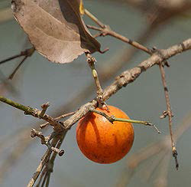
NUX VOMICA FRUIT

Slide 11
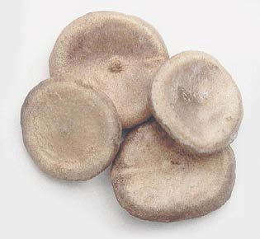
NUX VOMICA SEED

Slide 12
CHEMICAL CONSTITUENTS
Strychnine and brucine are two most important and toxic alkaloids present in the seeds (0.4% and 0.6%, respectively).
Other parts of tree have varying percentages of these two alkaloids— 1.7% and 2.8% in root bark, 0.3% and 0.4% in root-wood, 0.9% and 2.1% in stem-bark, 0.5% and 0.01% in stem-wood, and 0.2% and 0.5% in leaves, respectively.

Slide 13
Seeds contain Powerful alkaloids Strychnine and brucine
Strychnine occurs as colourless, odourless, rhombic prisms, having an intensely bitter taste
The bark contains only brucine
Fruit pulp ‐‐‐ low strychnine content

Slide 14
USES
• In Chinese herbal medicine, the seeds of strychnine
are eaten to alleviate external pains.
• Different types of tumors as well as allay paralysis
such as Bell’s palsy or facial paralysis.
• Useful herbal medicine
• Ingredient of homeopathic medication and is
particularly recommended for digestive problems,
• As a respiratory stimulant
• As a rodenticide
• For killing stray dogs, even wild animals

Slide 15
ABSORPTION AND EXCRETION
All mucous membrane
Much is taken by liver, muscle to be either released again into blood stream
This release produces convulsions on the 2nd or 3rd day
80% is oxidised mainly in the liver
Excreted slowly by the kidneys and traces in the bile, milk and saliva

Slide 16
SIGNS AND SYMPTOMS OF POISONING
When crushed seeds are taken symptoms delayed for
1 hr
If alkaloid taken symptoms appear immediately ( in 5‐
15 min)
Bitter taste, sense of uneasiness and restlessness
and feeling of suffocation and fear, and difficulty in
swallowing occurs
Convulsions are preceded by
1) Increased acuity of perception
2) Increased rigidity of muscles
3) Muscle twitching

Slide 17
Convulsions are produced due to direct action on the reflex centres of the spinal cord, and affect all the muscles at a time
First clonic then tonic
During convulsions face is cyanosed and has anxious look, eyes are staring, eyeballs prominent, pupils dilated
Risus sardonicus
Mouth covered with froth, frequently blood stained
Convulsion most marked in anti gravity muscles produces OPISTHOTONUS

Slide 18
Duration of convulsion‐ ½ to 2 min
• In between the convulsion the muscles are completely relaxed and the patient looks well though somewhat exhausted and the breathing is resumed
• Cyanosis lessens, cold perspirations covers the skin, dilated pupils may contract
• After 5‐15 min, or on slightest impulse, e.g. a
sudden noise, a current of air, or gently touching
the patient, another convulsion occurs

Slide 19
The patient cannot breath because the diaphragm
and the thoracic muscles are fully contracted
• Hypoxia causes medullary paralysis and death
• In non fatal cases interval b/w convulsions become longer and the spasm less, until these entirely stop within 12 to 24 hrs, and recovery takes place in a day or two

Slide 20
FATAL DOSE : 50‐100MG, OR ONE CRUSHED SEED
FATAL PERIOD: 1‐2 HRS

Slide 21
PATHOPHYSIOLOGICAL ACTION
• Competitively blocks ventral horn motor neuron and postganglionic receptor sites in the spinal cord and prevent the effect of GLYCINE and produces paralysis
• Widespread inhibition in the spinal cord results in “release” excitation
• Action in anterior horn cells
• It stimulates the cerebral cortex and produces hyper-reflexes and senses become acute

Slide 22
Sensory Nerves : Extreme hyperaesthesia
Motor nerves : Paralysis
Senses : vision increased, hearing augmented, sense of smell increased
GIT : Increased appetite, vomiting, gastralgia
Male sexual organs : Increased sexual desire, Impotency
Female sexual organs : Menses appear too soon and last too long

Slide 23
PHARMACOLOGICAL ACTION
2 TYPES OF ACTION
Hyper – reflexia produces oversensitivity, irritability, convulsions, neuralgia, fainting, hysteria, suicidal tendency
Paralysis and exhaustion due to blocking action of neurotransmitters

Slide 24
Is a stomachic tonic, increasing the vascularity of the gastric mucosa
Increases the gastric juice secretion
Increases biliary and pancreatic juice secretion
It deranges digestion
Stimulates the peristalsis of the intestine and renders them irregular and produces constipation

Slide 25
DRUG PICTURE
Adapted to thin, irritable, careful, zealous persons with dark hair and bilious or sanguine temperament. Disposed to be quarrelsome, spiteful, malicious; nervous and melancholic.
Debauchers of a thin, irritable, nervous disposition : prone to indigestion and haemorrhoids .
“Nux is chiefly successful with persons of an ardent character; of an irritable, impatient temperament, disposed to anger, spite or deception.”-Hahnemann.

Slide 26
Anxiety with irritability and inclination to commit suicide, but is afraid to die.
Hypochondriac: literary, studious persons, who are too much at home, suffer from want of exercise, with gastric, abdominal complaints and costiveness; especially in drunkards.
Oversensitive: to external impressions; to noise, odors, light or music ; trifling ailments are unbearable ; every harmless word offends .
Persons who are very particular, careful, but inclined to become easily excited or angered: irascible and tenacious.

Slide 27
Bad effects of :
coffee, tobacco, alcoholic stimulants; highly spiced or seasoned food; over-eating (ant. c.); long-continued mental over-exertion; sedentary habits; loss of sleep ; aromatic or patent medicine; sitting on cold stones, especially in warm weather

Slide 28
Convulsions, with consciousness ; < anger, emotion, touch, motion
Pains are tingling, sticking, hard, aching, worse from motion and contact.
Tendency to faint from odors; in morning; after eating; after every labor pain.

Slide 29
Cannot keep from falling asleep in the evening while sitting or reading hours before bedtime, and awakes at 3 or 4 a.m. ; falls into a dreamy sleep at daybreak from which he is hard to arouse, and then feels tired and weak
Catarrh: snuffles of infants ; coryza, dry at night, fluent by day; < in warm room, >> in cold air; from sitting in cold places, on stone steps.

Slide 30
Eructation: sour, bitter; nausea and vomiting every morning with depression of spirits; after eating.
Nausea: constant; after eating; in morning; from smoking; and feels “if could only vomit i would be so much better.”
Stomach : pressure an hour or two after eating as from a stone ; pyrosis, tightness, must loosen clothing; cannot use the mind for two or three hours after a meal; sleepy after dinner; from anxiety, worry, brandy, coffee, drugs, night watching, high living, etc.

Slide 31
Constipation; with frequent unsuccessful desire, passing small quantities of faeces ; sensation as if not finished.
Frequent desire for stool; anxious, ineffectual, > for a time after stool; in morning after rising; after mental exertion
Alternate constipation and diarrhoea in persons who have taken purgatives all their lives.

Slide 32
Menses : too early, profuse, lasts too long; or keeping on several days longer, with complaints at onset and remaining after; every two weeks; irregular, never at right time; stopping and starting again (sulph.); during and after, < of old symptoms.
Labor pains : violent, spasmodic; cause urging to stool or to urinate; < in back; prefers a warm room.

Slide 33
Strangulated hernia, especially umbilical.
Backache: must sit up or turn over in bed; lumbago; from sexual weakness, from masturbation.
Repugnance to cold or to cold air; chilly, on least movement; from being uncovered; must be covered in every stage of fever- chill, heat or sweat.
Fever : great heat, whole body burning hot (acon.), face red and hot (bell.), yet patient cannot move or uncover without being chilly.

Slide 34
Relations. Complementary : sulphur in nearly all diseases.
Nux should be given on retiring or, what is better, several hours before going to bed; it acts best during repose of mind and body.
Aggravation. Morning; waking at 4 a.m. ; mental exertion; after eating or over-eating; touch, noise, anger, spices, narcotics, dry weather; in cold air.
Amelioration. In evening, while at rest; lying down, and in damp wet weather .

